Slide 1

Short Term Goal and First Portfolio Submission

Slide 2
Travelport Products
three different Travelport products. Explain each product in reasonable detail and how it benefits our customers. Submit this along with your first portfolio submission
SmartPoint
Trip Services API/ JSON API → GraphQL
Search control Console – renamed to agent content manager and now content optimizer

Slide 3
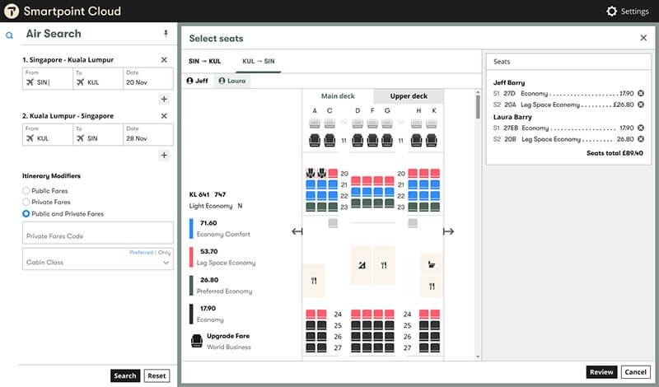
Smartpoint
Application program used to evaluate pricing, distance, and costs of multiple items, such as flights, cars and hotels.
The items are listed in a user friendly interface that speeds up the agents processing time.
https://www.travelport.com/products/smartpoint

Slide 4
Smartpoint
Access to the world’s airline, hotel, and car rental suppliers
Support both cryptic and rich graphical interfaces
Personalized workflows and plug-ins
Simpler, faster refunds and exchanges
Rich hotel retail tools, including maps, pictures, driving and walking directions, among many others
Real-time Covid-19 updates on local restrictions
Access to NDC(New Distribution Capability) content
Allows airlines to market themselves and make the brand distinguishable
Enables better control of pricing strategies
https://www.travelport.com/products/smartpoint

Slide 5
Smartpoint
Huge benefits to the agents
The items are listed in a user-friendly interface that speeds up the agent’s processing time.
- Streamlines agent onboarding and training
- Drives process efficiency and agent productivity
Information is consolidated from multiple sources to make it easy to search for travel, hotel or cars seamlessly
- Saves time
- Easier fare comparison
- Information is listed within the same workflow
Overall better customer service
- Faster and easier process makes it easier to focus on what matters most, the customer
https://www.travelport.com/products/smartpoint

Slide 6
JSON API – formerly Trip Services
Micro-services-based API structure, available through one simple programming interface
Digital access to content from traditional and new sources, covering air, hotel, car and rail
Typical sub-two-second search response time
Industry-standards format, for rapid integration into your digital platforms
Automatically follows EU recommendations to offer a high-speed rail alternatives to a traditional air option.
Split ticketing, ancillary management, branded fares
Reference implementations for fast onboarding
Best practices examples from other users

Slide 7
JSON API – formerly Trip Services
Sub-agents gained the ability to connect to the Travelport platform using a simple interface that allows them to check specific routes, fares and availability so they can create the quote themselves instead of going through the internal team
This speeds up process time and delivers value to the customer
Agents got access and autonomy to do what works best for them and the customer
50% increase in volume in sales
Faster access to branded offers, fares and ancillaries
Fast access to high volumes of data
Also prompts agent with upsell opportunities at select times during booking process

Slide 8
Potential GraphQL Adoption from JSON API – formerly Trip Services
Important to develop APIs that support delivery of that data in a concise and consistent way that can prevent over/under fetching currently found in existing model. The previous platform has experienced performance issues, resulting in the expansion of architecture complexity which causes challenges in maintenance and cost of the platform. However
Leveraging GraphQL Server can mitigate the previous performance and data access issues by creating a federated data graph of various data sources and the ability of GraphQL queries to allow user or service to consume only data that they need. Using this technology should increase speed, efficiency, improve deployment of new features, improve customer satisfaction and improve architecture

Slide 9
Search control Console – renamed to Agent Content Manager and now Content Optimizer
Web based tool used to tailor shopping and pricing behavior
Used for online and offline customers
Allows the creation of “business rules” to manipulate the content returned by a users search result. Helps to increase revenue by making search content more relevant to the travelers and more aligned to business objectives

Slide 10
Search control Console – renamed to Agent Content Manager and now Content Optimizer
Increases website engagement
Control supplier preferences
Maintain relationships with suppliers
Manage fare margins
Refine content served to corporate customers
Provide consistent experience across all sales channels
Differentiate content offers by target audience
Cost effective APU sales channels

Slide 11
Search control Console – renamed to Agent Content Manager and now Content Optimizer
Allows agent to be in control of their search requests and can filter out the request instead of the response
Flight Targeting
Can set up filtered searches by using a rules engine
Restricts/block carriers and carrier connections
Restricts specific flights and ranges
Restrict the number of connections/connection times
Checks Availability
Controls Pricing
Restricts fares, booking classes, fare basis codes, cabins, etc
Validates carrier override
Diversity
Restricts the number of options returned

